Slide 1

PROJECT ON
FACE MASK DETECTION
SUBMITTED BY:
YUGANTER SHARMA
SUBMITTED TO:
MUSKESH SIR(CS DEPARTMENT)
RIET, JAIPUR

Slide 2
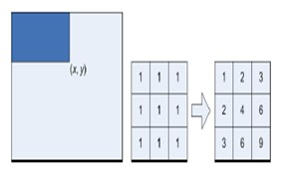
Integral Image
Summation of the pixel values
of the original image.
Value at location (x,y) = sum of
values of pixels above and
to the left of (x,y).
Whole image converted to integral image and a window buffer used to scan the entire image

Slide 3
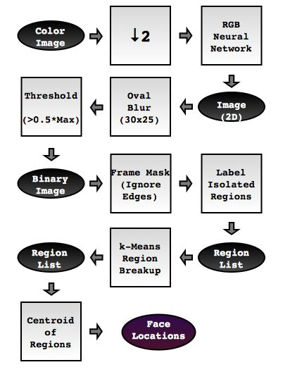
High-Level System Design
Face Color Detection
Region of Interest Isolation
Final Decison

Slide 4
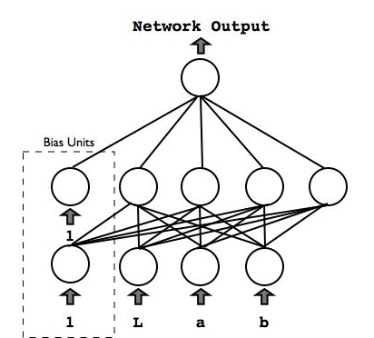
Skin Color Detection: Neural Network
TRAINING
Stochastic Backpropagation
Training patterns pre-whitened.
Learning rate, η, decreased with each training epoch.
Train on equal number of skin and non-skin pixels.
Training takes 10 minutes.
NETWORK TOPOLOGY AND COLORSPACE CHOICES
Choose number of hidden units
Pixel color can be expressed in multiple colorspaces
  RGB Lab, XYZ, and HSV
  RGB provided fewest false positives
RUNNING
Extremely Efficient
  All image pixels can be processed in under 1s.

Slide 5
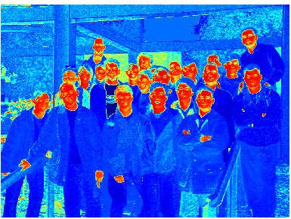

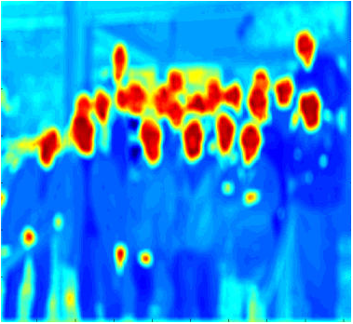
Isolate Face Shapes: Convolving with Mask
Resulting image from neural net had regions of interests that were not true faces.
The unique oval-shape true faces was used.
To isolate most probable regions of interest, the test image is convolved with an oval mask.

Slide 6
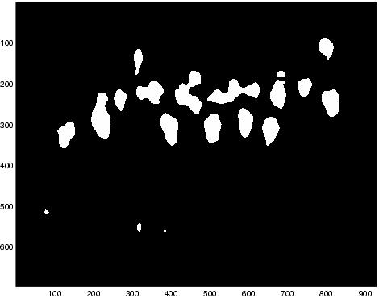

Narrowing Possible Face Locations
Increases speed of detection algorithm.
Test images showed that the faces were usually clustered.
We risk eliminating true faces, but we reject more false positives.

Slide 7
Morphological Processing
Segmented and processed Image consists of all skin regions (face, arms and fists)
Need to identify centers of all objects, including individual faces among connected faces
Repeated EROSION is done with specific structuring element

Slide 8
Template Matching
Data set has 145 male and 19 female faces
Need to identify region around estimated centroids as face or non-face
Multi-resolution was attempted. But distortion from neighboring faces gives false values
Smaller template has better result for all face shapes
Template used is the mean face of 50x50 pixels

Slide 9
EigenFace based detection
Decompose faces into set of basis images
Different methods of candidate face extraction from image
Minimum Distance between vector of coefficients to that of the face dataset was the metric.
It depends very much on spatial similarity to trained dataset
Slight changes give incorrect results
Hence, only template matching was used

Slide 10
Gender classification
Eigenfaces and template matching for specific face features do not yield good results
Other features for specific females were used – the headband
Template matching was performed for it
Conservative estimate was done to prevent falsely identifying males as a female

Slide 11


Split Multi-Face Images: k-Means Clustering
Regions may contain more than one face.
Estimate number of faces using the Distance Transform
  Use this estimate to initialize k.
Feature vectors are (x,y) locations of each pixel in the region.
Assign each pixel to one of k new regions.

Slide 12
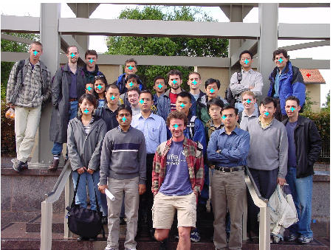
Results on Training Images
 | Misses | Repeats | False Pos
Image 1 | 2 | 0 | 0
Image 2 | 2 | 3 | 3
Image 3 | 1 | 0 | 1
Image 4 | 3 | 0 | 0
Image 5 | 1 | 1 | 1
Image 6 | 2 | 0 | 0
Image 7 | 3 | 1 | 0
System runtime under 10s on average
Simplest algorithm actually worked best!

Slide 13
Problems Encountered
Differences amongst colorspaces
  e.g., Lab misidentifies red shirts as skin.
  Final implementation used RGB neural net only.
System parameters
  Threshold for finding peaks during face color detection.
  Aggressiveness of the k-means region breakup.
  Finding the optimal set of parameters is a hard problem.

Slide 14
Failed Approaches
Adaptive thresholding for face color detection.
Morphological operations to clean up color segmentation results.
Eigenfaces
Template matching
  Average face
  Average eyes
  Average “eye-frames”
  Difficult to interpret correlation results.

Slide 15
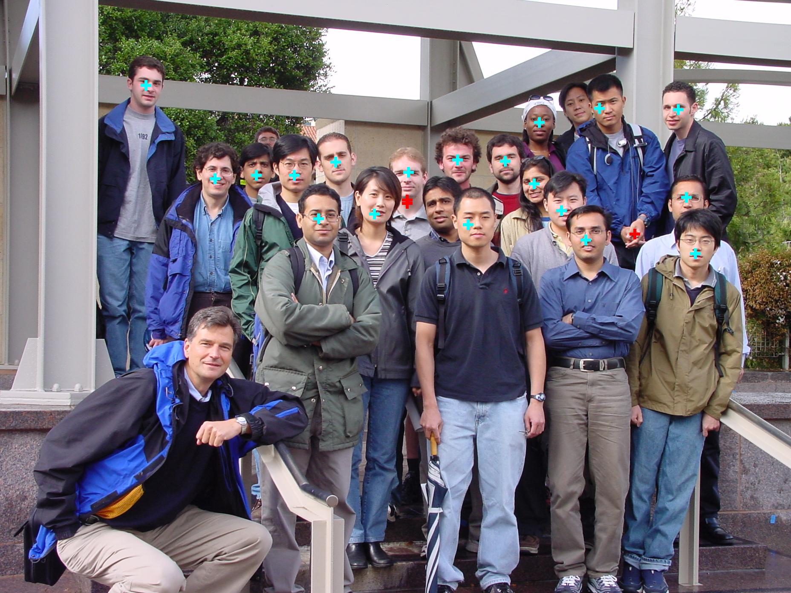

Slide 16
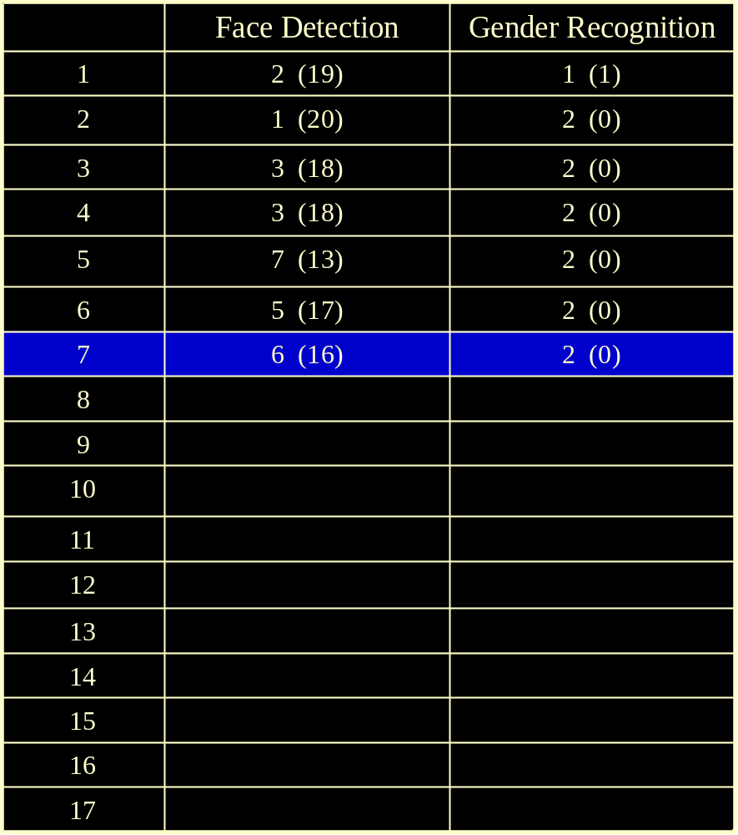

Slide 17
Conclusion
RGB Vector Quantization gave excellent segmentation
Morphological processing gave good estimate of centroids
Template matching with illumination correction gave near perfect results
Specific female was identified with headband

Slide 18
Future Considerations
Edge detection to better separate the connected faces
Preprocess the image in HSV space before codebook comparison to improve runtime
Improve rejection of highly correlated non-face objects

Slide 19
THANKYOU!

